Slide 1
Azure Databricks - Overview
Farah Omer
Jake Wang

Slide 2
The modern data estate
LOB
CRM
Graph
Image
Social
IoT
Hybrid
Operational databases
Operational databases
Data warehouses
Data warehouses
Data Lakes
Data Lakes
Reason over any data, anywhere
Flexibility of choice
Security and performance
Notes:
All kinds of data being generated
Stored on-premises and in the cloud – but vast majority in hybrid
Reason over all this data without requiring to move data
They want a choice of platform and languages, privacy and security
<Transition> Microsoft’s offerng

Slide 3
Big Data & Advanced Analytics in Azure

Slide 4
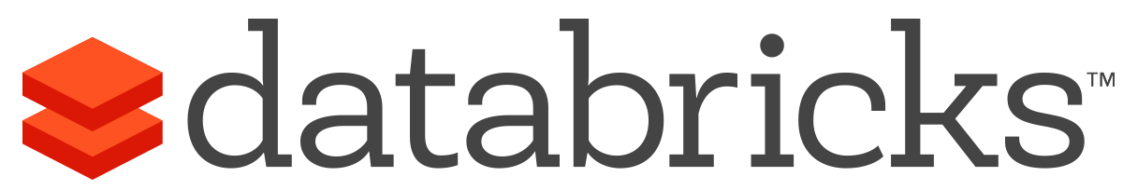


What is Azure Databricks?
A fast, easy and collaborative Apache® Spark™ based analytics platform optimized for Azure
Best of Databricks
Best of Microsoft
Designed in collaboration with the founders of Apache Spark
One-click set up; streamlined workflows
Interactive workspace that enables collaboration between data scientists, data engineers, and business analysts.
Native integration with Azure services (Power BI, SQL DW, Cosmos DB, Blob Storage)
Enterprise-grade Azure security (Active Directory integration, compliance, enterprise-grade SLAs)
Notes:
Azure Databricks features –
Enhance your teams’ productivity
Get started quickly by launching your new Spark environment with one click.
Share your insights in powerful ways through rich integration with PowerBI.
Improve collaboration amongst your analytics team through a unified workspace.
Innovate faster with native integration with rest of Azure platform.
Build on the most compliant and trusted cloud
Simplify security and identity control with built-in integration with Active Directory.
Regulate access with fine-grained user permissions to Azure Databricks’ notebooks, clusters, jobs and data.
Build with confidence on the trusted cloud backed by unmatched support, compliance and SLAs.
Scale without limits
Operate at massive scale without limits globally.
Accelerate data processing with the fastest Spark engine.

Slide 5
Big Data & Advanced Analytics at a glance
Ingest
Store
Prep & Train
Model & Serve
Intelligence
Business apps
Data Factory
(Data movement, pipelines & orchestration)
Cosmos DB
Predictive apps
Blobs
Data Lake
Databricks
HDInsight
Data Lake Analytics
SQL
Custom apps
Kafka
10 01
SQL Database
SQL Data Warehouse
Operational reports
Event Hub
IoT Hub
Machine Learning
Sensors and devices
Analysis Services
Analytical dashboards
Notes:
Azure build-out of DMSA. Supports hybrid\on-premises too through ADF \ Blob \ Stretch.

Slide 6


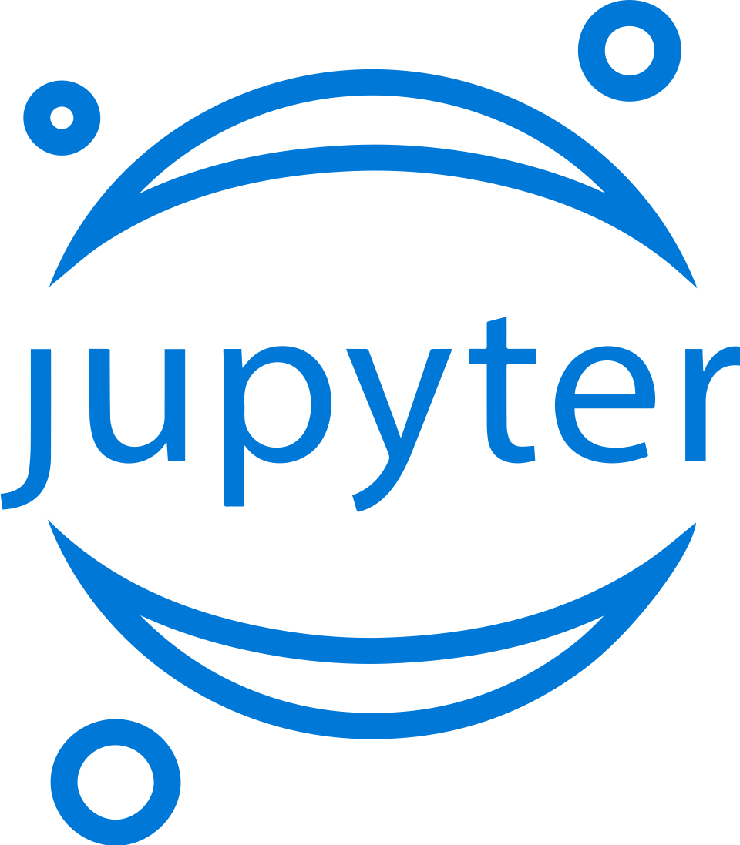



Machine Learning
Domain specific pretrained models
To simplify solution development
…
Vision
Speech
Language
Search
Familiar Data Science tools
To simplify model development
Visual Studio Code
Azure Notebooks
Jupyter
Command line
Popular frameworks
To build advanced deep learning solutions
PyTorch
TensorFlow
Scikit-Learn
ONNX
Productive services
To empower data science and development teams
Azure Databricks
Azure Machine Learning
Machine Learning VMs
Powerful infrastructure
To accelerate deep learning
CPU
GPU
FPGA
From the Intelligent Cloud to the Intelligent Edge

Slide 7
Azure Databricks Powered by Apache Spark
Notes:
One of the important pieces is Data Ingestion which is ADF, ADF connects to 80+ sources and Nithesh gave you an overview of that. I am next going to talk about Databricks – once you ingest the data, then the next step as part of your ETL pipeline is the data transfortmation, dat aprep and all that. And finally consumption happens.
How does Databricks help in this data engineering flow as part of data txn, data prep and all that. So lets go ahead and talk about it.

Slide 8

Why Spark?
Open-source data processing engine built around speed, ease of use, and sophisticated analytics
In memory engine that is up to 100 times faster than Hadoop
Largest open-source data project with 1000+ contributors
Highly extensible with support for Scala, Java and Python alongside Spark SQL, GraphX, Streaming and Machine Learning Library (Mllib)
Notes:
It’s a Managed Spark offering.
Apart from Open source apache spark, there are a lot of addnl capabilities . Things like better performance, things like capabilities of Databricks Delta, or capabilities like DB IO caching. Or things like autoscale of not just compute but the local storage;
One click deployment of workspace, integration with other services.
When it comes to ease of use, Spark again happens to be a lot better than Hadoop. Spark has APIs for several languages such as Scala, Java and Python, besides having the likes of Spark SQL. It is relatively simple to write user-defined functions. It also happens to boast an interactive mode for running commands. Hadoop, on the other hand, is written in Java and has earned the reputation of being pretty difficult to program, although it does have tools that assist in the process. (To learn more about Spark, see How Apache Spark Helps Rapid Application Development.)
In-Memory Technology
One of the unique aspects of Apache Spark is its unique "in-memory" technology that allows it to be an extremely good data processing system. In this technology, Spark loads all of the data to the internal memory of the system and then unloads it on the disk later. This way, a user can save a part of the processed data on the internal memory and leave the remaining on the disk.
Spark also has an innate ability to load necessary information to its core with the help of its machine learningalgorithms. This allows it to be extremely fast.
Spark’s Core
Spark’s core manages several important functions like setting tasks and interactions as well as producing input/output operations. It can be said to be an RDD, or resilient distributed dataset. Basically, this happens to be a mix of data that is spread across several machines connected via a network. The transformation of this data is created by a four-step method, comprised of mapping the data, sorting it, reducing it and then finally, joining the data.
Following this step is the release of the RDD, which is done with support from an API. This API is a union of three languages: Scala, Java and Python.
Spark’s SQL
Apache Spark’s SQL has a relatively new data management solution called SchemaRDD. This allows the arrangement of data into many levels and can also query data via a specific language.
Graphx Service
Apache Spark comes with the ability to process graphs or even information that is graphical in nature, thus enabling the easy analysis with a lot of precision.
Streaming
This is a prime part of Spark that allows it to stream large chunks of data with help from the core. It does so by breaking the large data into smaller packets and then transforming them, thereby accelerating the creation of the RDD.
MLib – Machine Learning Library
Apache Spark has the MLib, which is a framework meant for structured machine learning. It is also predominantly faster in implementation than Hadoop. MLib is also capable of solving several problems, such as statistical reading, data sampling and premise testing, to name a few.

Slide 9
Differentiated experience on Azure
ENHANCE PRODUCTIVITY
BUILD ON THE MOST COMPLIANT CLOUD
SCALE WITHOUT LIMITS
Get started quickly by launching your new Spark environment with one click.
Share your insights in powerful ways through rich integration with Power BI.
Improve collaboration amongst your analytics team through a unified workspace.
Innovate faster with native integration with rest of Azure platform
Simplify security and identity control with built-in integration with Active Directory. Regulate access with fine-grained user permissions to Azure Databricks’ notebooks, clusters, jobs and data.
Build with confidence on the trusted cloud backed by unmatched support, compliance and SLAs.
Operate at massive scale without limits globally.
Accelerate data processing with the fastest Spark engine.
Notes:
Databricks, founded by the team that created Apache Spark – unified analytics platform that accelerates innovation by unifying data science, engineering & business.
75% of the code committed to Apache Spark comes from Databricks
Unified Runtime
Create clusters in seconds, dynamically scale them up and down.
They’ve made enhancements to Spark engine to make it 10x faster than open source Spark
Serverless- Auto-configured multi-user cluster, Reliable sharing with fault isolation
Unified Collaboration
Overall – a simple & collaborative environment that enables your entire team to use Spark & interact with your data simultaneously
DE – Improve ETL performance, zero management clusters. Execute production code from within notebooks
DS - For data scientists, easy data exploration in notebooks
Business SME – interactive dashboards empower teams to create dynamic reports
Enterprise Security
Encryption
Fine grained Role-based access control (files, clusters, code, application, dashboard)
Compliance
Rest APIs
DE – DBIO, SPARK, API’s , JOBS
DS – Spark and Serverless, Interactive Data Science
Data Products - Everything
Creators of Spark
Training People
Number of Customers
Ingest
Workflow
Schedule / Run / Monitor
Execute
Troubleshoot
Debug
Production Jobs
---------
Ingest, ETL, Scheduling, Monitoring

Slide 10

Available Regions
Central US
East US
East US 2
North Central US
North Europe
South Central US
West US
West US 2
Australia Central
Australia Central 2
Australia East
Australia Southeast
Canada Central
Canada East
Central India
East Asia
Japan East
Japan West
South India
Southeast Asia
UK South
UK West
West Europe
West India

Slide 11

Azure Databricks
Azure Databricks
Collaborative Workspace
IoT / streaming data
Machine learning models
DATA ENGINEER
DATA SCIENTIST
BUSINESS ANALYST
Deploy Production Jobs & Workflows
Cloud storage
BI tools
MULTI-STAGE PIPELINES
JOB SCHEDULER
NOTIFICATION & LOGS
Data warehouses
Optimized Databricks Runtime Engine
Data exports
Hadoop storage
DATABRICKS I/O
APACHE SPARK
SERVERLESS
Rest APIs
Data warehouses
Enhance Productivity
Build on secure & trusted cloud
Scale without limits
Notes:
At a high level, there are 3 different personas.
We cater for Data analysis so Data scientist is one set of user persona. So they can use things like ML, Deep learning.
ML data scientist can use the capabilities of Databricks to create the model.
2nd persona is Data engineer. So you want to schedule jobs, we have the concept of job cluster and all these can be orchestrated through Data factory.
Finally there is business Analyst persona. You want to see some graphs, visualization in the Dbricks notebooks. So Dbricks supports that in the Notebook itself.
Databricks, founded by the team that created Apache Spark – unified analytics platform that accelerates innovation by unifying data science, engineering & business.
75% of the code committed to Apache Spark comes from Databricks
Unified Runtime
Create clusters in seconds, dynamically scale them up and down.
They’ve made enhancements to Spark engine to make it 10x faster than open source Spark
Serverless- Auto-configured multi-user cluster, Reliable sharing with fault isolation
Unified Collaboration
Overall – a simple & collaborative environment that enables your entire team to use Spark & interact with your data simultaneously
DE – Improve ETL performance, zero management clusters. Execute production code from within notebooks
DS - For data scientists, easy data exploration in notebooks
Business SME – interactive dashboards empower teams to create dynamic reports
Enterprise Security
Encryption
Fine grained Role-based access control (files, clusters, code, application, dashboard)
Compliance
Rest APIs
DE – DBIO, SPARK, API’s , JOBS
DS – Spark and Serverless, Interactive Data Science
Data Products - Everything
Creators of Spark
Training People
Number of Customers
Ingest
Workflow
Schedule / Run / Monitor
Execute
Troubleshoot
Debug
Production Jobs
---------
Ingest, ETL, Scheduling, Monitoring

Slide 12
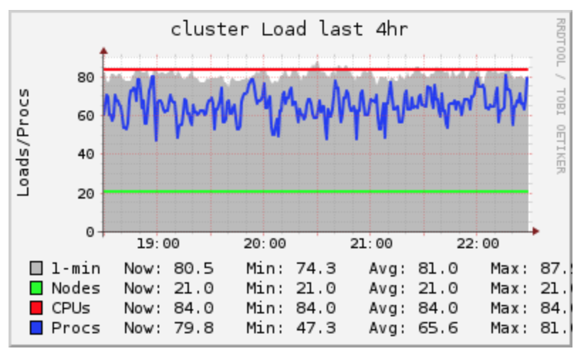
Infinite Scale, Lower Cost, Zero Management
1 to 1000s of Worker Nodes
Auto-scale Compute & Storage
Auto-Recovery & Upgrade

Slide 13
Your Language, Your Data (Anywhere), Your Format
SQL, Python, Scala & R Support
Code in your favorite language
Source data from File System, Object stores, HDFS, Database, Pub-Sub systems & Others
Read and write data from/to multiple sources
Optimized for Azure Blob Store, ADLS, SQLDW, Event Hubs & Cosmos DB
File Formats
CSV, JSON, Parquet, Text, ORC, XML & More

Slide 14
Collaborative Workspace
GET STARTED IN SECONDS
Single click to launch your new Spark environment
INTERACTIVE EXPLORATION
Explore data using interactive notebooks with support for multiple programming languages including R, Python, Scala, and SQL
COLLABORATION
Work on the same notebook in real-time while tracking changes with detailed revision history, GitHub, or Bitbucket
VISUALIZATIONS
Visualize insights through a wide assortment of point-and-click visualizations. Or use powerful scriptable options like matplotlib, ggplot, and D3
DASHBOARDS
Rich integration with PowerBI to discover and share your insights in powerful new ways
Azure Databricks
Collaborative Workspace
DATA ENGINEER
DATA SCIENTIST
BUSINESS ANALYST
Deploy Production Jobs & Workflows
MULTI-STAGE PIPELINES
JOB SCHEDULER
NOTIFICATION & LOGS
Optimized Databricks Runtime Engine
DATABRICKS I/O
APACHE SPARK
SERVERLESS
Rest APIs
Notes:
Databricks, founded by the team that created Apache Spark – unified analytics platform that accelerates innovation by unifying data science, engineering & business.
75% of the code committed to Apache Spark comes from Databricks
Unified Runtime
Create clusters in seconds, dynamically scale them up and down.
They’ve made enhancements to Spark engine to make it 10x faster than open source Spark
Serverless- Auto-configured multi-user cluster, Reliable sharing with fault isolation
Unified Collaboration
Overall – a simple & collaborative environment that enables your entire team to use Spark & interact with your data simultaneously
DE – Improve ETL performance, zero management clusters. Execute production code from within notebooks
DS - For data scientists, easy data exploration in notebooks
Business SME – interactive dashboards empower teams to create dynamic reports
Enterprise Security
Encryption
Fine grained Role-based access control (files, clusters, code, application, dashboard)
Compliance
Rest APIs
DE – DBIO, SPARK, API’s , JOBS
DS – Spark and Serverless, Interactive Data Science
Data Products - Everything
Creators of Spark
Training People
Number of Customers
Ingest
Workflow
Schedule / Run / Monitor
Execute
Troubleshoot
Debug
Production Jobs
---------
Ingest, ETL, Scheduling, Monitoring

Slide 15
Deploy Production Jobs & Workflows
JOBS SCHEDULER
Execute jobs for production pipelines on a specific schedule
NOTEBOOK WORKFLOWS
Create multi-stage pipelines with the control structures of the source programming language
RUN NOTEBOOKS AS JOBS
Turn notebooks or JARs into resilient Spark jobs with a click or an API call
NOTIFICATIONS AND LOGS
Set up alerts and quickly access audit logs for easy monitoring and troubleshooting
INTEGRATE NATIVELY WITH AZURE SERVICES
Deep integration with Azure SQL Data Warehouse, Cosmos DB, Azure Data Lake Store, Azure Blob Storage, and Azure Event Hub
Azure Databricks
Collaborative Workspace
DATA ENGINEER
DATA SCIENTIST
BUSINESS ANALYST
Deploy Production Jobs & Workflows
MULTI-STAGE PIPELINES
JOB SCHEDULER
NOTIFICATION & LOGS
Optimized Databricks Runtime Engine
DATABRICKS I/O
APACHE SPARK
SERVERLESS
Rest APIs
Notes:
Databricks, founded by the team that created Apache Spark – unified analytics platform that accelerates innovation by unifying data science, engineering & business.
75% of the code committed to Apache Spark comes from Databricks
Unified Runtime
Create clusters in seconds, dynamically scale them up and down.
They’ve made enhancements to Spark engine to make it 10x faster than open source Spark
Serverless- Auto-configured multi-user cluster, Reliable sharing with fault isolation
Unified Collaboration
Overall – a simple & collaborative environment that enables your entire team to use Spark & interact with your data simultaneously
DE – Improve ETL performance, zero management clusters. Execute production code from within notebooks
DS - For data scientists, easy data exploration in notebooks
Business SME – interactive dashboards empower teams to create dynamic reports
Enterprise Security
Encryption
Fine grained Role-based access control (files, clusters, code, application, dashboard)
Compliance
Rest APIs
DE – DBIO, SPARK, API’s , JOBS
DS – Spark and Serverless, Interactive Data Science
Data Products - Everything
Creators of Spark
Training People
Number of Customers
Ingest
Workflow
Schedule / Run / Monitor
Execute
Troubleshoot
Debug
Production Jobs
---------
Ingest, ETL, Scheduling, Monitoring

Slide 16
Optimized Databricks Runtime Engine
OPTIMIZED I/O PERFORMANCE
The Databricks I/O module (DBIO) takes processing speeds to the next level — significantly improving the performance of Spark in the cloud
FULLY-MANAGED PLATFORM ON AZURE
Reap the benefits of a fully managed service and remove the complexity of big data and machine learning
SERVERLESS INFRASTRUCTURE
Databricks’ serverless and highly elastic cloud service is designed to remove operational complexity while ensuring reliability and cost efficiency at scale
OPERATE AT MASSIVE SCALE
Without limits globally
Azure Databricks
Collaborative Workspace
DATA ENGINEER
DATA SCIENTIST
BUSINESS ANALYST
Deploy Production Jobs & Workflows
MULTI-STAGE PIPELINES
JOB SCHEDULER
NOTIFICATION & LOGS
Optimized Databricks Runtime Engine
DATABRICKS I/O
APACHE SPARK
SERVERLESS
Rest APIs
Notes:
Databricks, founded by the team that created Apache Spark – unified analytics platform that accelerates innovation by unifying data science, engineering & business.
75% of the code committed to Apache Spark comes from Databricks
Unified Runtime
Create clusters in seconds, dynamically scale them up and down.
They’ve made enhancements to Spark engine to make it 10x faster than open source Spark
Serverless- Auto-configured multi-user cluster, Reliable sharing with fault isolation
Unified Collaboration
Overall – a simple & collaborative environment that enables your entire team to use Spark & interact with your data simultaneously
DE – Improve ETL performance, zero management clusters. Execute production code from within notebooks
DS - For data scientists, easy data exploration in notebooks
Business SME – interactive dashboards empower teams to create dynamic reports
Enterprise Security
Encryption
Fine grained Role-based access control (files, clusters, code, application, dashboard)
Compliance
Rest APIs
DE – DBIO, SPARK, API’s , JOBS
DS – Spark and Serverless, Interactive Data Science
Data Products - Everything
Creators of Spark
Training People
Number of Customers
Ingest
Workflow
Schedule / Run / Monitor
Execute
Troubleshoot
Debug
Production Jobs
---------
Ingest, ETL, Scheduling, Monitoring

Slide 17
Key Databricks Features
DATABRICKS INTERACTIVE CLUSTERS
Persistent clusters for analytics
Auto-scaling
Multi-user sharing and collaboration per cluster
DATABRICKS WORKSPACE
SQL Python R and Scala notebooks
One-click visualization
Interactive dashboards
Collaboration
Revision history
GitHub integration
DATABRICKS DELTA
Optimize Spark Queries for faster Analytics, better data reliability guarantees and simplified data pipelines
Handles 3 main challenges(Data reliability, Performance challenges and System Complexity)
Indexing, Statistics and Caching Support
Unified Batch and Stream Processing
Transactional Guarantees
Notes:
Challenges: Data reliability
Schema changes, there are different readers and writers for data and they are viewing it at different points of time and data is not consistent. So how do we guarantee consistency of data. Delta solves that by the concept of transaction logs just like reln databases. What happens in Databricks Delta is under the scenes, we use the concept of logs, where as new writes come, it goes through these logs and its logged and then its available in the data storage say BLOB storage or wherever that data is that you are writing to. Any read that comes, it will go through the log, take a look at the snapshot, what time the write happened and it will give that view to the user. So that is how it guarantees ACID transaction capabilities for the data.
The next thing is also schema enforcement. With Delta, if the data is coming in realtime manner, you can enforce that if the data matches this schema, then only write it to my multi hop pipeline of the data. So in that way, in realtime manner, you don’t have to go to the start of the ETL pipeline, and redo it. As part of the pipeline, delta does it for you.
2nd is Performance challenges: In real time streatming scenarios, you are paying the performance penalty by incurring the I/O bandwidth. Or you are paying the performance penalty especially when you are for ex doing a query without any intelligence in the query – it will then go ahead and scan the full table. You are looking for just one specific record, why do you have to scan the full table or file. Databricks Delta has the ability to intelligently query or scan that specific section of the data where the data lives so you don’t have to incur performance penalty.
If you think about the lambda architecture, you have one pipeline where you are responsible for operational analytics for historical data; and you have one pipeline for Real time data. Now as you try to do all these optimizations, by writing your own low level code, whether its doing file compaction by yourself, you have to do it as your business requirements or data pipeline engineering requirements change, with Delta you don’t have to do it; because all these capabilities exist by default so you as a user just get to use it without writing the low level code. So from architecture perspective its very simplified.

Slide 18





Azure Databricks Delta
Handle terabytes & petabytes of data
Low latency streaming ingestion
Avoid corrupt & messy data while reading & writing
Control on how to adapt to changing schema
Enable scientists & analysts to read data quickly for interactive analysis - Indexing
Notes:
So in general – it can handle handle TB and PB of data. This is not unique to Delta, its also available as part of Azure DB.
The 2nd one is low latency streaming ingestion. For RT analytics, it is very powerful tool.
You get to avoid corrupt and messy data. In the usecase like where you don’t have to go back to start of the pipeline; rather as the data is flowing in, you can upserts as part of the pipeline itself.
You can adapt towards the schema changes and then one of the powerful capabilities that delta also does is that it uses the concept of z-ordering which means that it will rearrange the data set in a way so that when the scanning of the query happens, it will scan only a sector of the data where the data lives for those specific queries. So that way the performance is much much faster.

Slide 19




Azure Databricks Delta – Fast Reads
Data format
Compaction
Partitioning
Indexing
Caching
Notes:
In the same thread, these are some of the things just to reiterate –
The data format, the compaction that it does for real time.
Partiitoning – now this is again not specific to delta but highlighted that it comes with it. The addnl indexing that you do is related to z-ordering. Caching, which is again not specific to Delta, where you know with Spark Databricks does the caching for you and and autoscales the local storage.

Slide 20
Databricks Delta – What’s New
Generally Available
Available in both Standard and Premium
Fast Parquet Import – Minutes to import TB size tables using ‘Convert to Delta’
Time Travel – Query a snapshot of the table using timestamp string (experimental)
Notes:
Its GA from Feb 1.
Its available in Std tier as well.
Now one of the things which is experimental is Time Travel. For ex going to a previous snapshot of the data. With Time travel you can go to a previous snapshot of the data if you are trying to debug or troubleshoot.
Customers who have already created regular Spark table in parquet format, but with the new feature called fast parquet import, you get to conver that table into Delta table within minutes and not hours.
In the past you would have to convert or create a new table that would take much longer time.

Slide 21
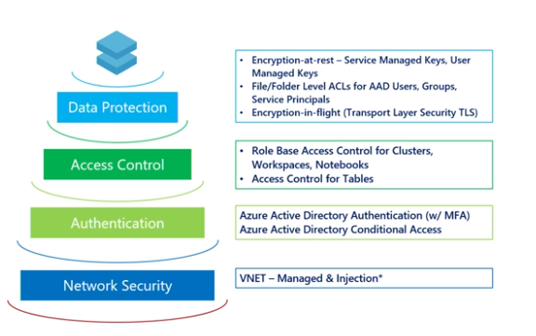
Enterprise Grade Security
Notes:
Azure Dbricks has separation of Compute and Storage.
Data at Rest is encrypted.
Data that’s in BLOB storage or ADLS you can use your own keys or you can rely on MSFT managed key. You can use Azure Keyvault to store those secrets.
All other data is also encrypted at rest.
Access Control – At a high level, Dbricks uses Notebooks, Dbricks clusters, which are all shared – You can go as an admin, create a workspace, and invite multiple users. But whats the benefit if everyone has access to everything. With Azure Dbricks you get access control at each layer whether its cluster interms of who can create restart or edit a cluster.
You have access control at the level of jobs. If you think of data engineering scenario, you can assign who can run some job, who can edit this job or manage this job.
Thinking of notebook, you can edit read/write permissions on notebooks. You can also hv permissions in terms of as an admin – who can go ahead and share this notebook with others as well. At the table and data level, you have Table based ACLS, saying this user has access to this table or that DB – so you have ACLs at all levels.
I wont go into deep in this but if needed we can.
There is also Azure AD in terms of authentication. No addl settings required. It’s a by default setup.
In adidiotn, there is this notion of conditional access. If you have a specific requirement of I want to lock down Azure Databricks to a specific set of n/w locations, you can do that through conditional access. You can also enforce multi factor authentication. You know AD has its own feature one of them is MFA – by default if you don’t have AD premium or AD conditional access you get the choiuce to enforce MFA on ALL or Enforce MFA on NONE– for the applications that perhaps wont require PII where you don’t want to enforce MFA.
Lastly, There is N/w level security where there is isolation of Vnets.

Slide 22
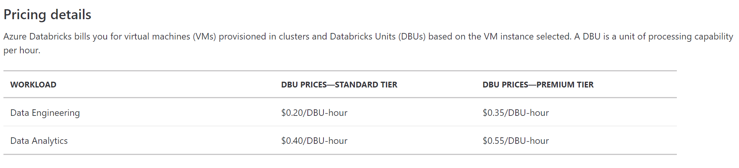
Pricing
Data Engineering workload -> Automated workloads
Data Analytics workload -> Interactive workloads

Slide 23
Use Cases

Slide 24
Modern Big Data Warehouse
Ingest
Store
Prep & Train
Model & Serve
Intelligence
Logs, files and media (unstructured)
Data factory
Azure storage
Azure Databricks
(Spark)
Business / custom apps
(Structured)
Polybase
Data factory
Azure SQL Data Warehouse
Analytical dashboards

Slide 25
Advanced Analytics on Big Data
Ingest
Store
Prep & Train
Model & Serve
Intelligence
Logs, files and media (unstructured)
Data factory
Azure storage
Azure Databricks
(Spark Mllib, SparkR, SparklyR)
Azure Cosmos DB
Web & mobile apps
Business / custom apps
(Structured)
Polybase
Data factory
Azure SQL Data Warehouse
Analytical dashboards

Slide 26
Real-time Analytics on Big Data
Ingest
Store
Prep & Train
Model & Serve
Intelligence
Unstructured data
Azure HDInsight (Kafka)
Azure Databricks
(Spark)
Polybase
Azure storage
Azure SQL Data Warehouse
Analytical dashboards

Slide 27
Getting Started

Slide 28
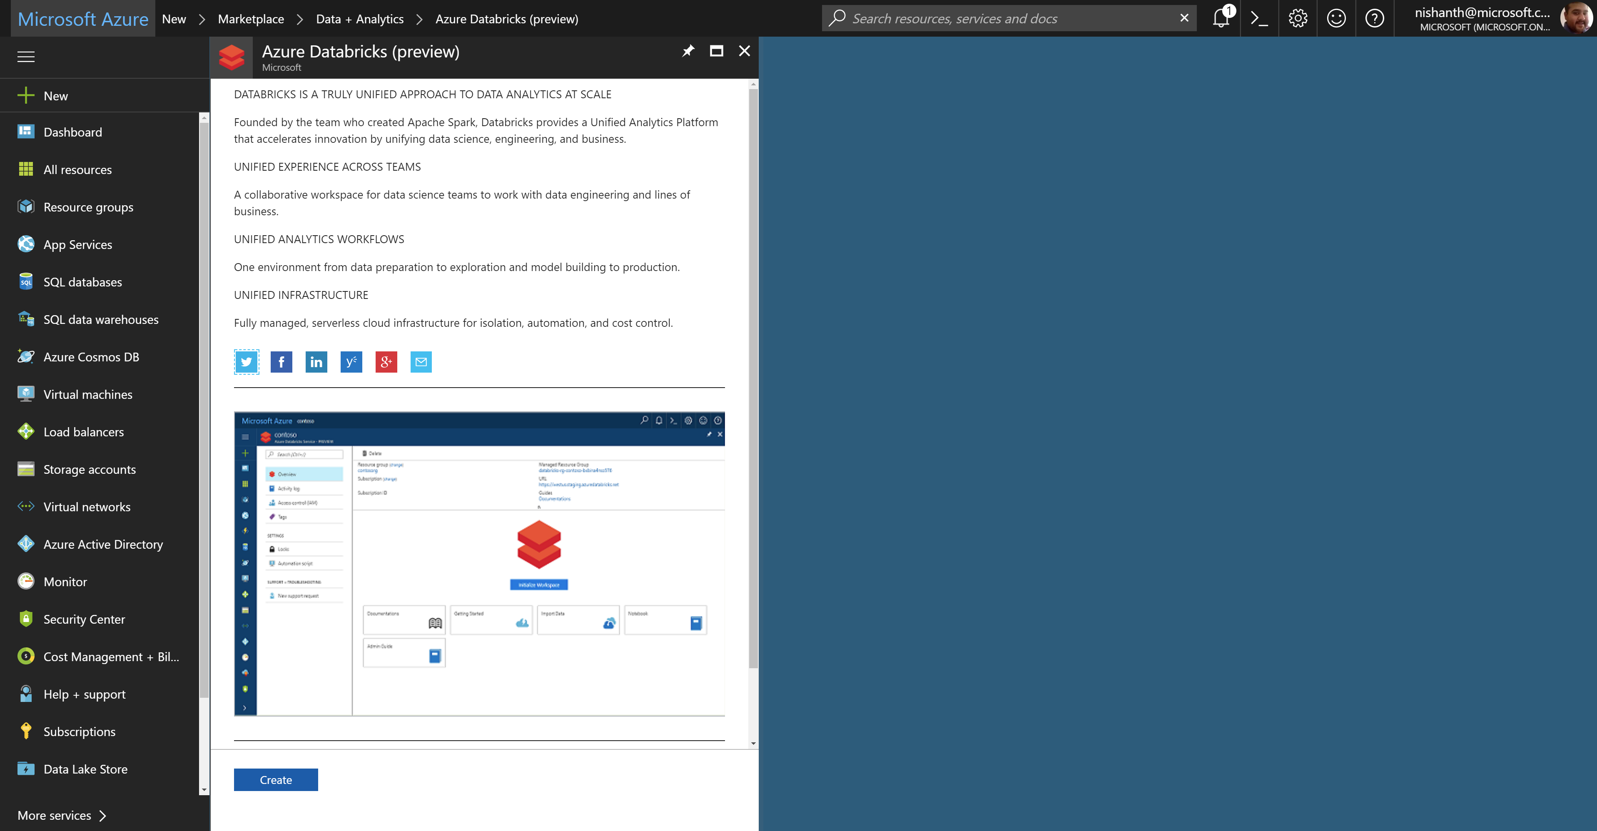
Azure Databricks – service home page

Slide 29
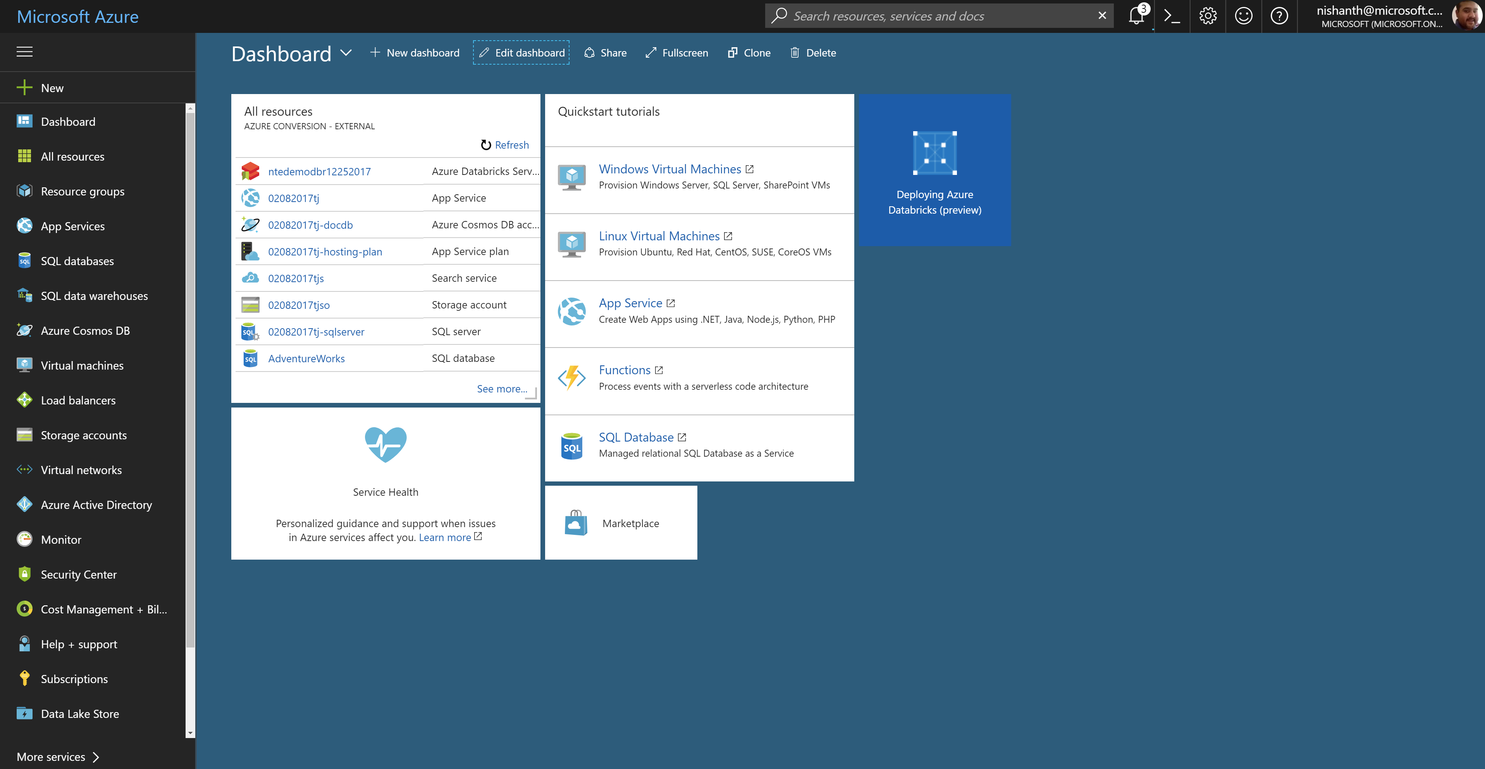
Azure Databricks – workspace deployment

Slide 30
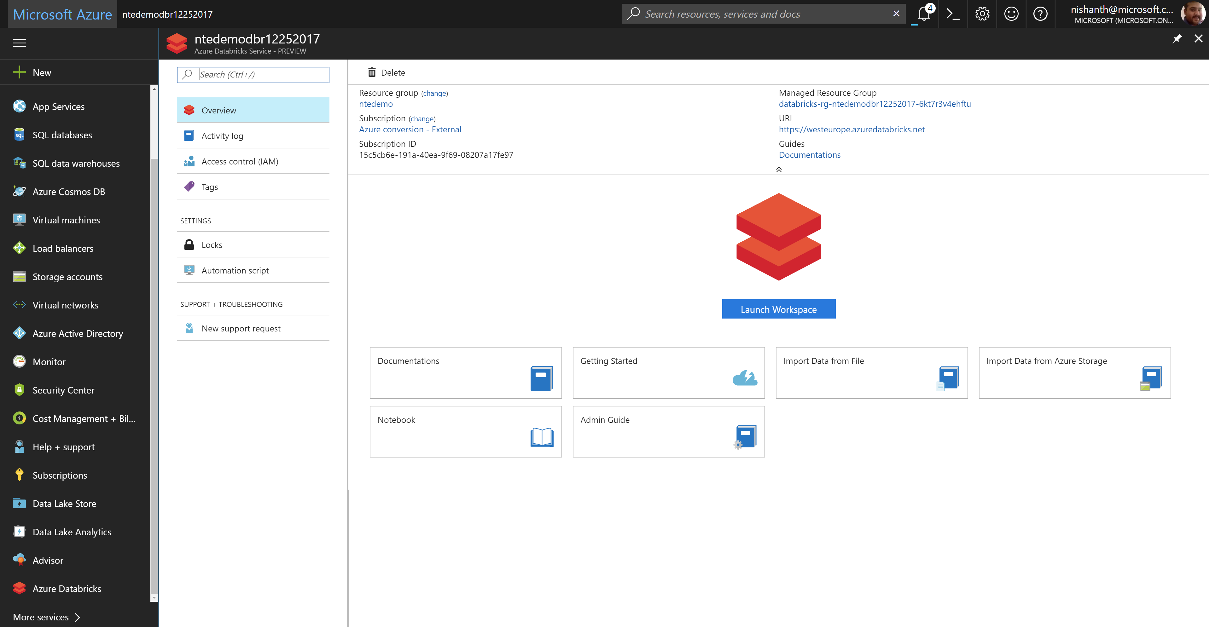
Azure Databricks – launching the workspace

Slide 31
Demo

Slide 32

How to get started
Try a Quickstart or Tutorial at: https://docs.microsoft.com/en-us/azure/azure-databricks/ https://github.com/MicrosoftLearning/databricks-intro
https://github.com/Azure/MachineLearningNotebooks/tree/master/how-to-use-azureml/azure-databricks
Engage Microsoft experts for a workshop to help identify high impact scenarios
Learn more about Azure Databricks www.azure.com/databricks
Notes:
Databricks, founded by the team that created Apache Spark – unified analytics platform that accelerates innovation by unifying data science, engineering & business.
75% of the code committed to Apache Spark comes from Databricks
Unified Runtime
Create clusters in seconds, dynamically scale them up and down.
They’ve made enhancements to Spark engine to make it 10x faster than open source Spark
Serverless- Auto-configured multi-user cluster, Reliable sharing with fault isolation
Unified Collaboration
Overall – a simple & collaborative environment that enables your entire team to use Spark & interact with your data simultaneously
DE – Improve ETL performance, zero management clusters. Execute production code from within notebooks
DS - For data scientists, easy data exploration in notebooks
Business SME – interactive dashboards empower teams to create dynamic reports
Enterprise Security
Encryption
Fine grained Role-based access control (files, clusters, code, application, dashboard)
Compliance
Rest APIs
DE – DBIO, SPARK, API’s , JOBS
DS – Spark and Serverless, Interactive Data Science
Data Products - Everything
Creators of Spark
Training People
Number of Customers
Ingest
Workflow
Schedule / Run / Monitor
Execute
Troubleshoot
Debug
Production Jobs
---------
Ingest, ETL, Scheduling, Monitoring

Slide 33
Q & A

Slide 34
Appendix

Slide 35
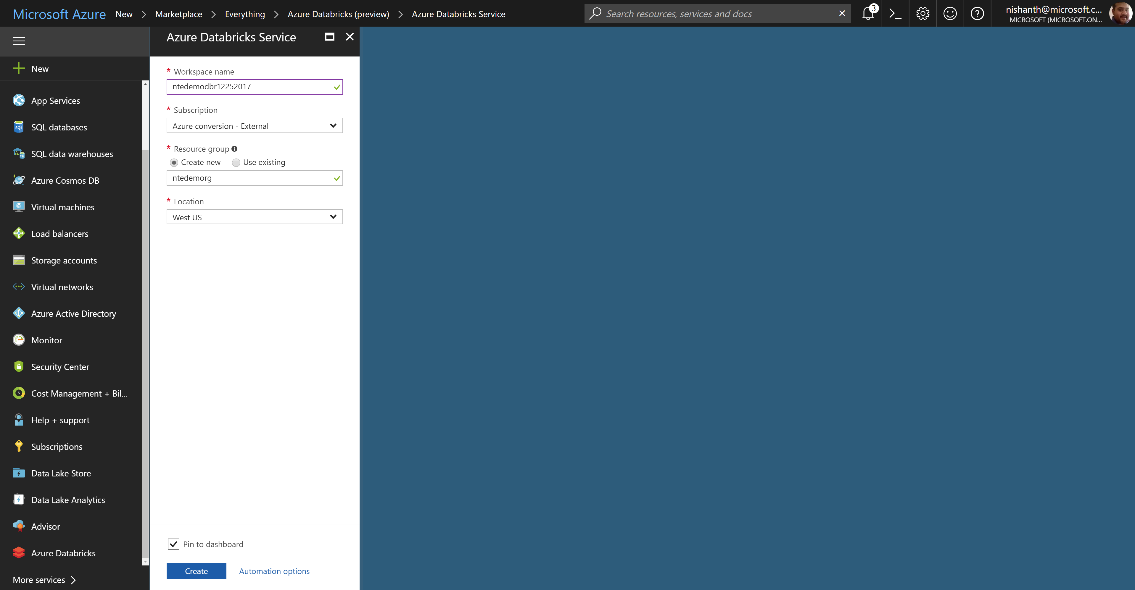
Azure Databricks – creating a workspace

Slide 36
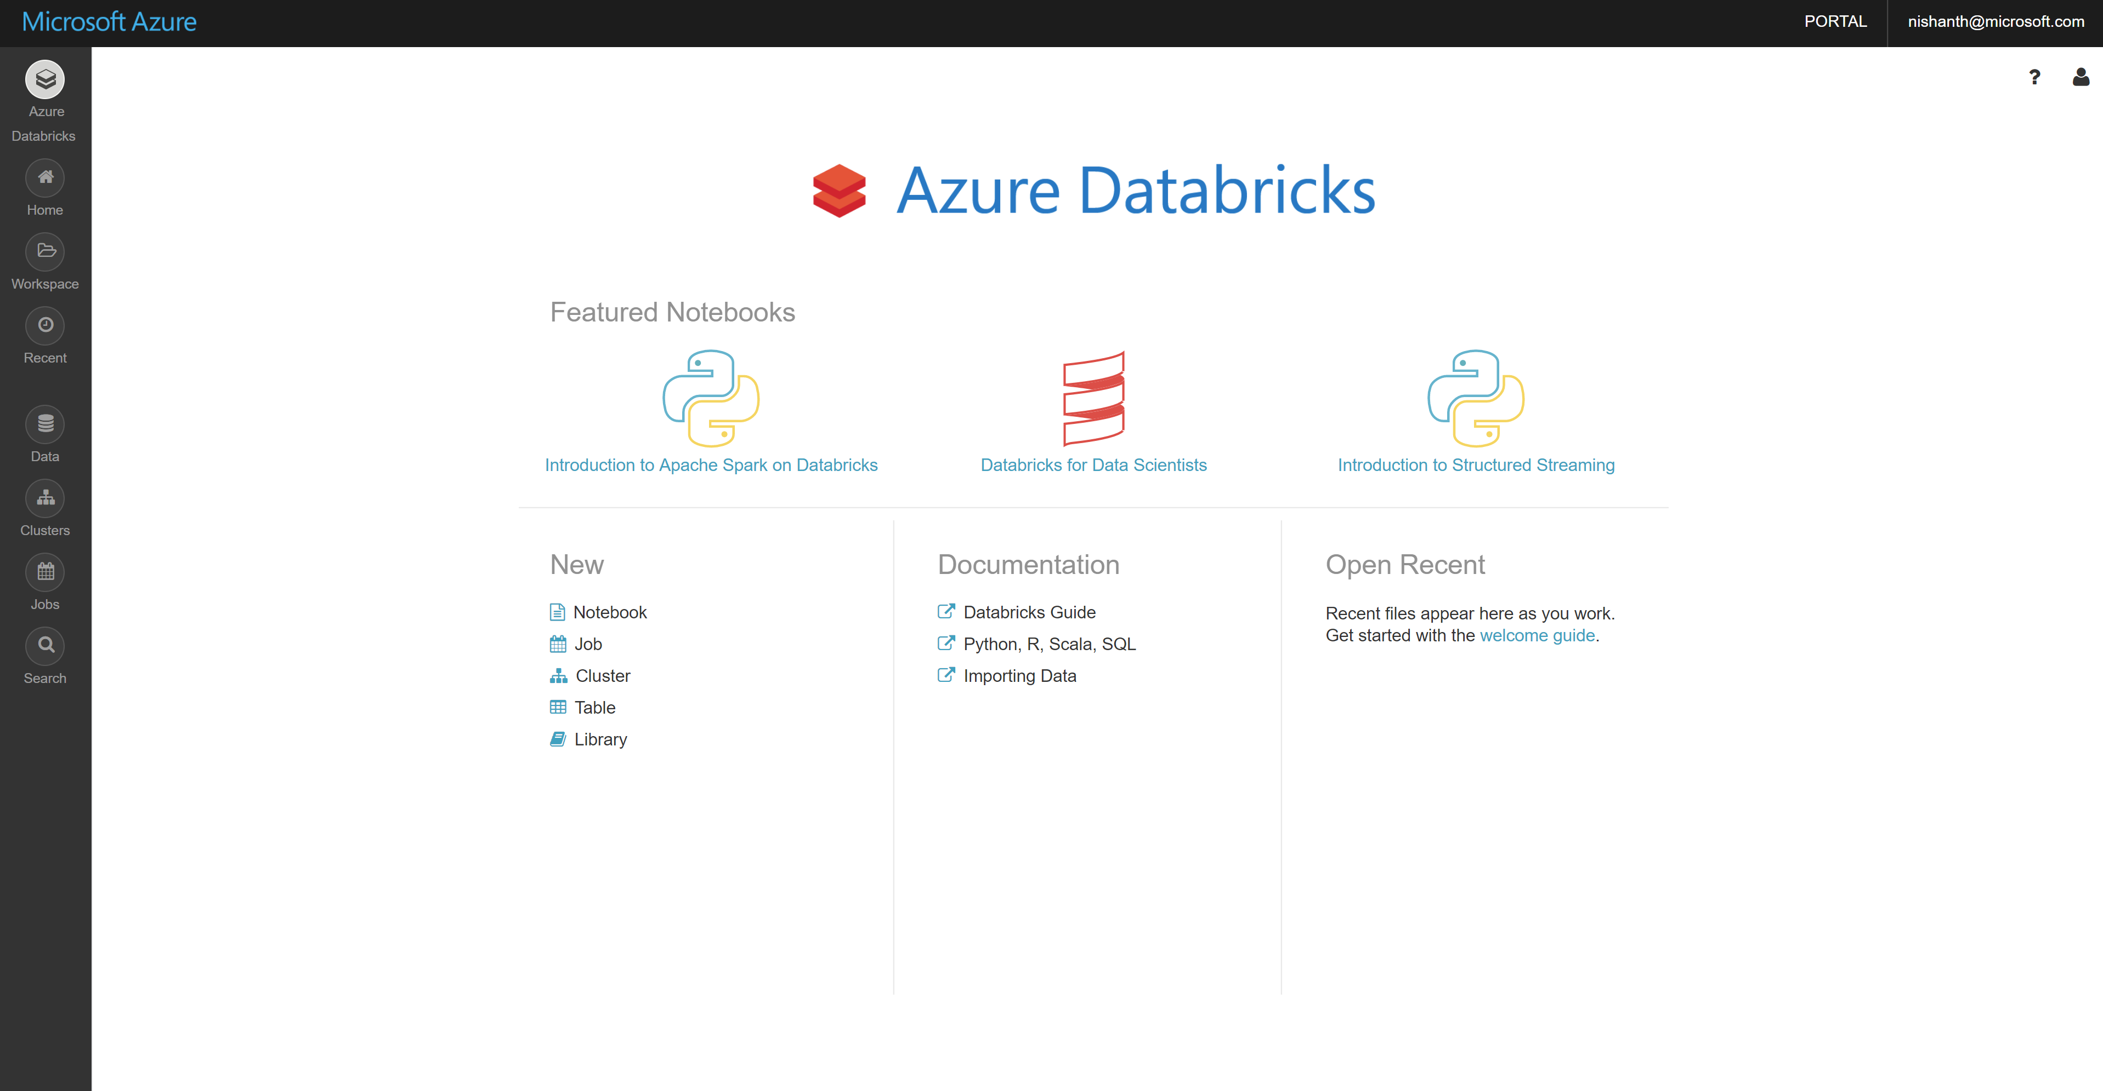
Azure Databricks – workspace home page

